Slide 1

Smart Shelves for Retail Stores
Presented
by
K Vasuki, 1RV14MCA42
Under the Guidance
of
Internal Guide External Guide
Dr. S. Anupama Kumar, Muthukumar Munuswamy(Manager),
Associate Professor Chethan Munikrishna(IT Architect)
Date:25 Feb’2017 Department of MCA,RVCE 1 / 13

Slide 2
Agenda
Synopsis
Introduction
Literature Survey
H/W & S/W for Development
Training Details
Work Progress
References
Date:25 Feb’2017 Department of MCA,RVCE 2 / 13

Slide 3
Synopsis
Digital transformation and E retailers urge the need to selling experience
Automate shelves to keep track of the inventory in a retail establishment
Cope up with in-store experience failures.
Auto tracking and remote monitoring.
Date:25 Feb’2017 Department of MCA,RVCE 3 / 13

Slide 4
Introduction
‘Out of Stock’ Challenge in Physical Stores
Dissatisfaction of the customers due to out of stock items
Refill stocks from stock room on depletion
Intimate the buying group regarding demand and Out of stock situation
Information to warehouse for immediate replenishment
How Smart Shelves in Physical Stores Work
Date:25 Feb’2017 Department of MCA,RVCE 4 / 13

Slide 5
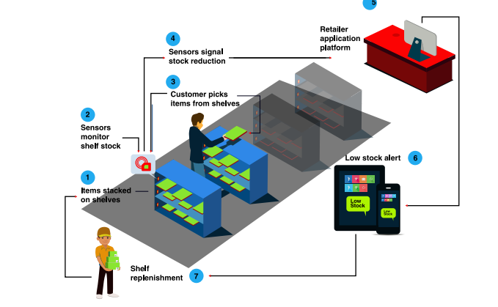
Date:25 Feb’2017 Department of MCA,RVCE 5 / 13

Slide 6
Features
Inventory Automation
Real time Inventory Management
Remote Monitoring Provision
Stock Availability Assessment
Hardware Compatibility
Date:25 Feb’2017 Department of MCA,RVCE 6 / 13

Slide 7
Business Benefits
• Reduction of ‘out-of-stock’ products
• Locate products easy and fast
• Store space optimization and better utilization of
in-store human resources
• Control and monitor the usage of high value items
• Increase operational efficiency and store effectiveness
Enhanced customer experience
Date:25 Feb’2017 Department of MCA,RVCE 7 / 13

Slide 8
Literature Survey
Sl No | Author | Title | Outcome
1 | Xianming Qing | Multiloop antenna for High Frequency RFID smart shelf Application | The proposed antenna prototype has been able to generate magnetic field with uniform magnitude for a larger interrogation region.
2 | Carla R. Medeiros Jorge R. Costa Carlos A. Fernandes | RFID Smart Shelf With Confined Detection Volume at UHF | The working frequency band covers simultaneously the three world assigned RFID subbands at ultrahigh frequency (UHF).
3 | Khan Nishiyama | A smart shelf, an efficient object identification system with battery less passive low frequency RFID tag | describes a system that uses an RFID module to harvest energy from an incoming radio signal both to power the circuitry in order to identify the object and to power an indicator LED.
Date:25 Feb’2017 Department of MCA,RVCE 8 / 13

Slide 9
Literature Survey
Sl No | Author | Title | Outcome
4 | D'Alessandro A. Buffi P. Nepa G. Isola | RFID-Based Smart Shelving Storage Systems | A RFID-Based Smart Shelving Storage System in UHF band is presented for localization of tagged items with specific reference to a pharmacy drawer for drug storage
5 | Soheyl Soodmand Tim W. C. Brown Alexander Gluhak | Evaluation of HF band NFC/RFID antennas for smart shelf applications | a new theoretical approach is presented to increase bandwidth of RFID reader antennas operating at HF band to improve the reception of the backscattered RFID response
6 | Andrey S. Andrenko | Optimized near-field antenna for UHF RFID smart shelf applications | The proposed antenna demonstrates excellent ability to provide strong and uniform E-field distribution at the distances up to 50 cm form the antenna surface.
Date:25 Feb’2017 Department of MCA,RVCE 9 / 13

Slide 10
H/W and S/W for development
Software Requirements | Net Beans (v8.2)
 | Node js (v6.4.0)
 | Mongo DB (v3.2.9)
 | Impinj Multi Reader (V6.6.16)
Hardware Requirements | RFID tags
 | RFID readers
 | Antennas
 | Vonets WiFi Bridge
Processor | 64-bit, four-core, 2.5 GHz minimum per core(Minimum)
RAM | 16GB(Minimum)
Date:25 Feb’2017 Department of MCA,RVCE 10 / 13

Slide 11
Training Details
From Date | To Date | Description of sessions
2nd Jan 2017 | 6th Jan 2017 | Architecture of project and existing systems
9th Jan 2017 | 13th Jan 2017 | basics of mongodb and nodejs
16th Jan 2017 | 20th Jan 2017 | Fundamentals of Express Framework
23rd Jan 2017 | 27th Jan 2017 | Basics of javascript and knockoutjs
30th Jan 2017 | 3rd Feb 2017 | Application development using express framework, nodejs & mongodb
6th Feb 2017 | 10th Feb 2017 | Data collection from the RFID Readers using Java
13th Feb 2017 | 17th Feb 2017 | API development to store the data in mongodb
20th Feb 2017 | 24th Feb 2017 | Participated in “Innovation week” organized by mercedes benz research and development.
Date:25 Feb’2017 Department of MCA,RVCE 11 / 13

Slide 12
Work Progress
Instructed to build a generic solution as base and use case at the end of next month
Data is collected from the readers and Rest API generated to push the data into database.
Data collection with RFID and Beacons accomplished.
UI for generic solution on process
Date:25 Feb’2017 Department of MCA,RVCE 12 / 13

Slide 13
Thank You
Date:25 Feb’2017 Department of MCA,RVCE 13 / 13

